Slide 1
ADVANCED PROGRAMMING PRACTICES
SOEN 6441 - Advanced Programming Practices
Model View Controller Architecture
Observer Pattern
Joey Paquet, 2007-2014

Slide 2
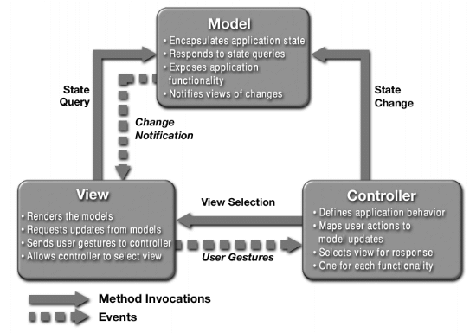
Model View Controller Architecture
SOEN 6441 - Advanced Programming Practices
MVC was first introduced by Trygve Reenskaug at the Xerox Palo Alto Research Center in 1979.
Part of the basic of the Smalltalk programming environment.
Widely used for many object-oriented designs involving user interaction.
A three-tier architectural model:
Joey Paquet, 2007-2014

Slide 3
MVC: model
SOEN 6441 - Advanced Programming Practices
Model:
  Manages the behavior and data of the application domain.
  Responds to requests for information about its state (usually from the view).
  Responds to instructions to change state (usually from the controller).
  In event-driven systems, the model notifies observers (usually views) when the information changes so that they can react. (see observer pattern)
  In enterprise software, a model often serves as a software approximation of a real-world process.
  In a game, the model is represented by the classes defining the game entities, which are embedding their own state and actions.
Joey Paquet, 2007-2014

Slide 4
MVC: view
SOEN 6441 - Advanced Programming Practices
View:
  Renders the model into a form suitable for visualization or interaction, typically a user interface element.
  Multiple views can exist for a single model element for different purposes.
  The view renders the contents of a portion of the model’s data.
  If the model data changes, the view must update its presentation as needed. This can be achieved by using:
    a push model, in which the view registers itself with the model for change notifications. (see the observer pattern)
    a pull model, in which the view is responsible for calling the model when it needs to retrieve the most current data.
Joey Paquet, 2007-2014

Slide 5
MVC: controller
SOEN 6441 - Advanced Programming Practices
Controller:
  Receives user input and initiates a response by making calls on appropriate model objects.
  Accepts input from the user and instructs the model to perform actions based on that input.
  The controller translates the user's interactions with the view it is associated with, into actions that the model will perform that may use some additional/changed data gathered in a user-interactive view.
  A controller may also spawn new views upon user demand.
Joey Paquet, 2007-2014

Slide 6
MVC: interactions between model, view and controller
SOEN 6441 - Advanced Programming Practices
Creation of a Model-View-Controller triad:
  The model objects are created, each representing a portion of the state held by the application.
  The views register as observers on the model objects. Any changes to the underlying data of the model objects immediately result in a broadcast change notification, which all associated views receive (in the push model). Note that the model is not aware of the view or the controller -- it simply broadcasts change notifications to all registered observers.
  The controller is bound to a view and can react to any user interaction provided by this view. This means that any user actions that are performed on the view will invoke a method in the controller class.
  The controller is given a reference to the underlying model, so that it can trigger the model’s behavior functions and/or state change when one of its methods is called.
Joey Paquet, 2007-2014

Slide 7
MVC: interactions between model, view and controller
SOEN 6441 - Advanced Programming Practices
Once a user interacts with the view, the following actions occur:
  The view recognizes that a GUI action -- for example, pushing a button or dragging a scroll bar -- has occurred, e.g using a listener method that is registered to be called when such an action occurs. The mechanism varies depending on the technology/library used.
  In the listener method, the view calls the appropriate method on the controller.
  The controller translates this signal into an appropriate action in the model, which will in turn possibly be updated in a way appropriate to the user's action.
  If some of the model’s elements have been altered, they then notify registered observers of the change. In some architectures, the controller may also be responsible for updating the view. Again, technical details may vary according to technology/library used.
Joey Paquet, 2007-2014

Slide 8
SOEN 6441 - Advanced Programming Practices
Observer pattern
Joey Paquet, 2007-2014

Slide 9
Observer pattern: motivation, intent
SOEN 6441 - Advanced Programming Practices
Motivation
  The cases when certain objects need to be informed about the changes occurring in other objects are frequent. To have a good design means to decouple as much as possible and to reduce the dependencies. The Observer Design Pattern can be used whenever a subject has to be observed by one or more observers.
Intent
  Define a one-to-many dependency between objects so that when one object changes state, all its dependents are notified and updated automatically.
This pattern is a cornerstone of the Model-View-Controller architectural design, where the Model implements the mechanics of the program, and the Views are implemented as Observers that are as much uncoupled as possible from the Model components.
Joey Paquet, 2007-2014

Slide 10
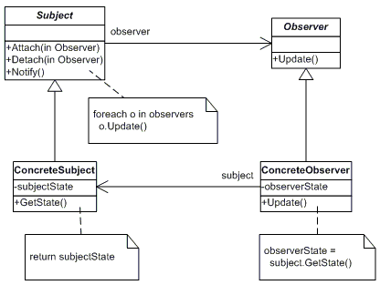
Observer pattern: design
SOEN 6441 - Advanced Programming Practices
“Model” classes
“View” classes
Joey Paquet, 2007-2014

Slide 11
Observer pattern: design
SOEN 6441 - Advanced Programming Practices
The participants classes in the Observer pattern are:
  Subject - interface or abstract class defining the operations for attaching and de-attaching observers to the client. It is often referred to as “Observable”.
  ConcreteSubject - concrete Subject class. It maintains the state of the observed object and when a change in its state occurs it notifies the attached Observers. If used as part of MVC, the ConcreteSubject classes are the Model classes that have Views attached to them.
  Observer - interface or abstract class defining the operations to be used to notify the registered Observer objects.
  ConcreteObserver - concrete Observer subclasses that are attached to a particular Subject class. There may be different concrete observers attached to a single Subject that will provide a different view of that Subject.
Joey Paquet, 2007-2014

Slide 12
Observer pattern: behavior
SOEN 6441 - Advanced Programming Practices
Behavior
  The client class instantiates the ConcreteObservable object.
  Then it instantiates and attaches the concrete observers to it using the methods defined in the Observable interface.
  Each time the (observable) state of the subject is changing, it notifies all the attached Observers using the methods defined in the Observer interface.
  When a new Observer is added to the application, all we need to do is to instantiate it in the client class and to add attach it to the Observable object.
  The classes already created will remain mostly unchanged.
Joey Paquet, 2007-2014

Slide 13

Observer pattern: implementation
SOEN 6441 - Advanced Programming Practices
Model classes need to be made subclasses of the Observable Java class.
When a part of their state that is observed is changed, call the setChanged() method to specify that the observed object’s state has been changed, then the notifyObservers() method that will notify all the attached observers by calling their update() method.
import java.util.Observable;
class ClockTimerModel extends Observable {
public
int GetHour(){return hour;};
int GetMinute(){return minute;};
int GetSecond(){return second;};
void tick(){
// update internal state
second ++;
if (second >= 60){
minute++; second = 0;
if (minute >= 60){
hour++; minute=0;
if (hour >= 24){
hour=0;
};
};
};
// specify that my state was changed
setChanged();
// notify all attached Observers of a change
notifyObservers(this);
};
void start(int secs){
for (int i = 1; i <= secs; i++)
tick();
};
private
int hour;
int minute;
int second;
};
Joey Paquet, 2007-2014

Slide 14

Observer pattern: implementation
SOEN 6441 - Advanced Programming Practices
View classes are subclasses of the Java Observer abstract class.
They need to implement the update() method that is called by the notifyObservers() method of the Observable class.
This method does the necessary updates to the view offered to the user (here a simple console output).
import java.util.Observable;
import java.util.Observer;
class DigitalClockView implements Observer {
public
void update(Observable obs, Object x) {
//redraw my clock’s reading after I was notified
int hour = ((ClockTimerModel) obs).GetHour();
int minute = ((ClockTimerModel) obs).GetMinute();
int second = ((ClockTimerModel) obs).GetSecond();
System.out.println(hour+":"+minute+":"+second);
};
};
Joey Paquet, 2007-2014

Slide 15

Observer pattern: implementation
SOEN 6441 - Advanced Programming Practices
The main program must:
Create the Model object.
Create the View object.
Connect the View object to the Model object.
Then, any change in the state of the Model object triggers the update of the Views attached to it.
import java.util.Scanner;
public class ObserverDemo extends Object {
ClockTimerModel clockModel;
DigitalClockView clockView;
public ObserverDemo() {
//create the Model object
clockModel = new ClockTimerModel();
//create the View object
clockView = new DigitalClockView();
//connect the View object to the Model object
clockModel.addObserver(clockView);
};
public static void main(String[] av) {
ObserverDemo od = new ObserverDemo();
od.demo();
};
public void demo() {
Scanner kbd = new Scanner(System.in);
int secs = kbd.nextInt();
clockModel.start(secs);
kbd.close();
};
};
Joey Paquet, 2007-2014

Slide 16
References
SOEN 6441 - Advanced Programming Practices
OODesign.com. Observer Pattern.
Erich Gamma, Richard Helm, Ralph Johnson and John Vlissides, Design Patterns – Elements of Reusable Object-Oriented Software, Addison-Wesley, 1995.
Joey Paquet, 2007-2014

